Slide 1
Amaru Cholango on How to Poeticize Technology
Sara Garzón
PhD Student
History of Art and Visual Studies
Cornell University

Slide 2
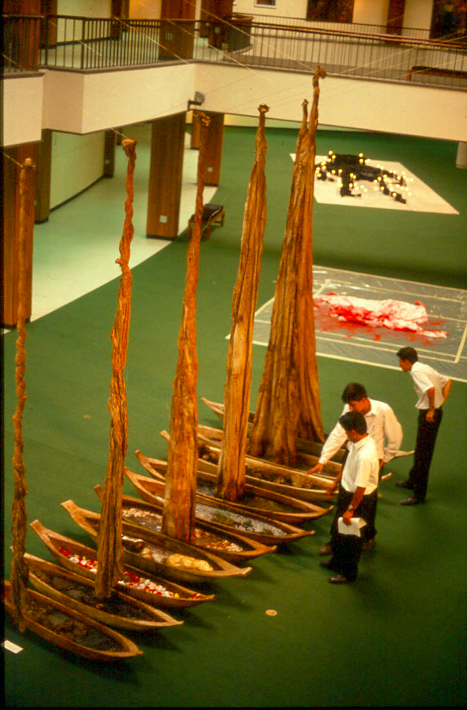
Amaru Cholango, Columbus‘ Caravels still Navigate on Earth, 1994. Canoes, petroleum, mud and dead fish. IV Cuenca Biennial.

Slide 3
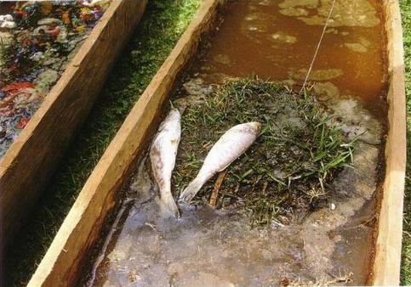
Amaru Cholango, Columbus‘ Caravels still Navigate on Earth (Detail), 1994. Canoes, petroleum, mud and dead fish. IV Cuenca Biennial.

Slide 4
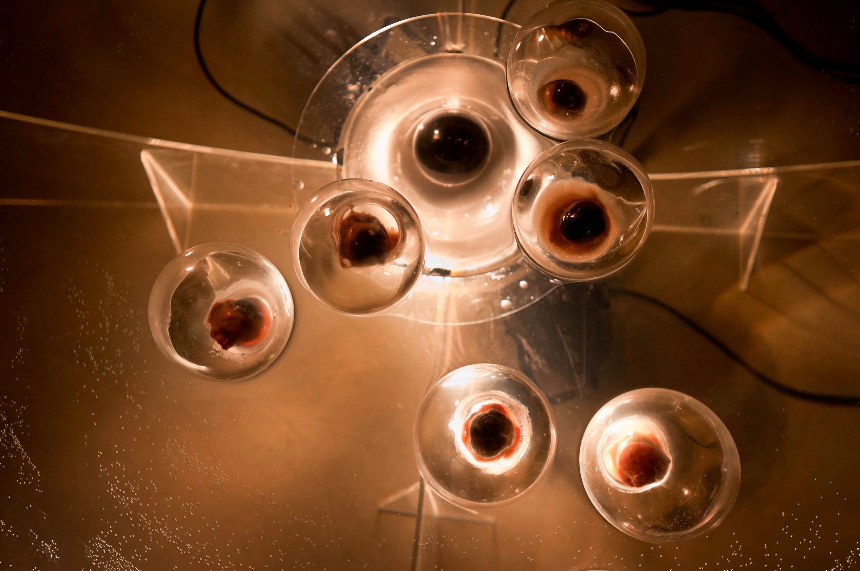
Amaru Cholango, Narciso, 2007. Glass balls, ox eyes, video surveillance camera, projector.

Slide 5
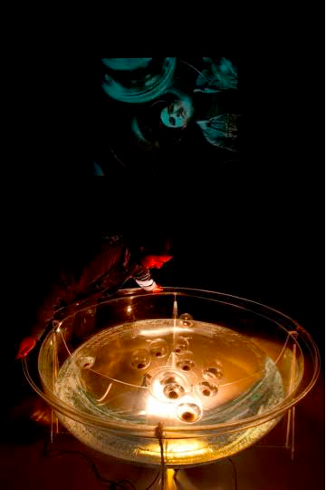
Amaru Cholango, Narciso, 2007. Glass balls, ox eyes, video surveillance camera, projector.

Slide 6
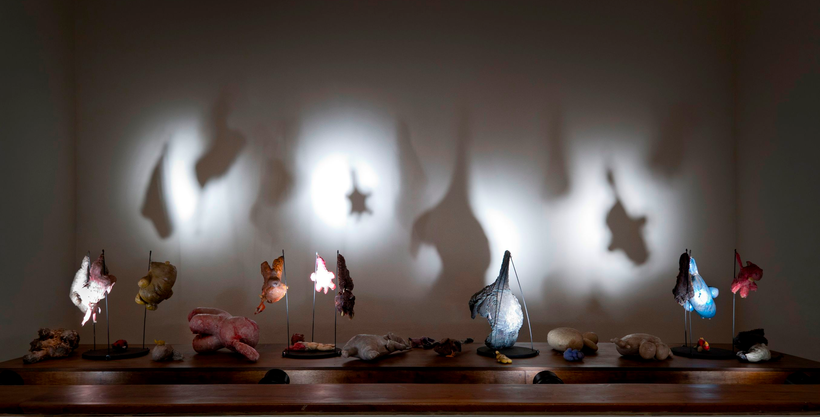
Amaru Cholango, Miran tus ojo la realided? (Can your eyes see reality?) 2011. Installation, stuffed dolls, wax.

Slide 7
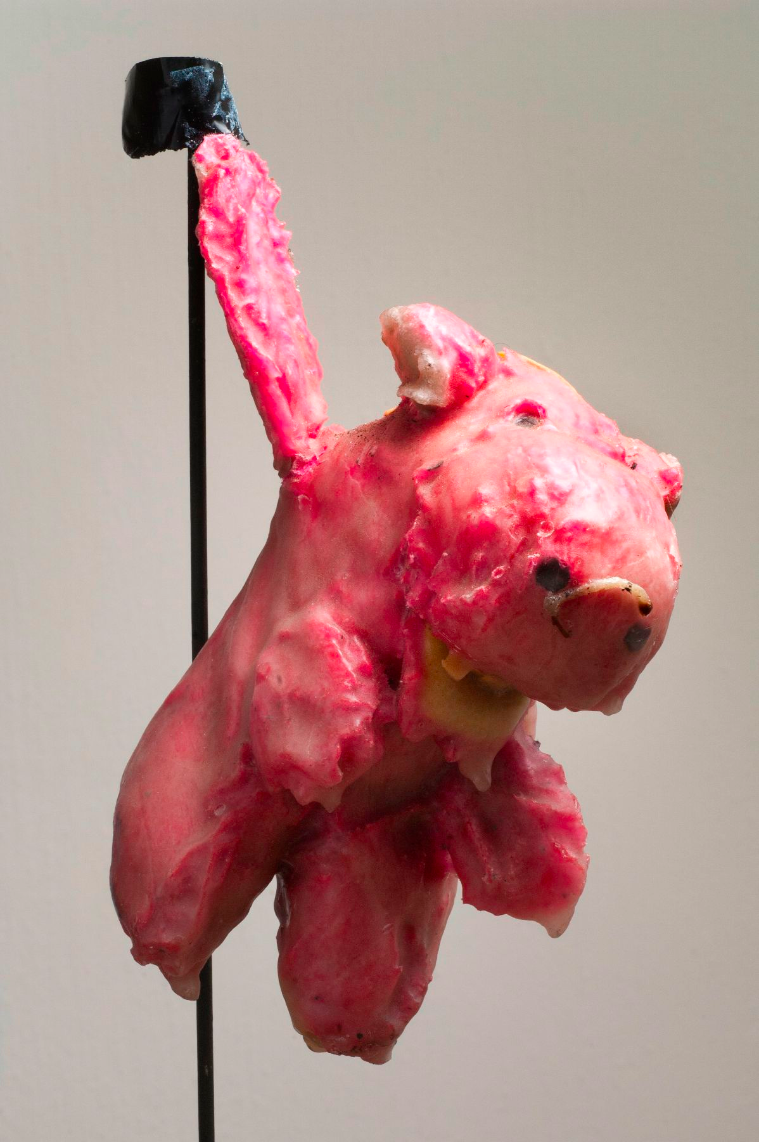
Amaru Cholango, Miran tus ojo la realided? (Can your eyes see reality?) 2011. Installation, stuffed dolls, wax.

Slide 9
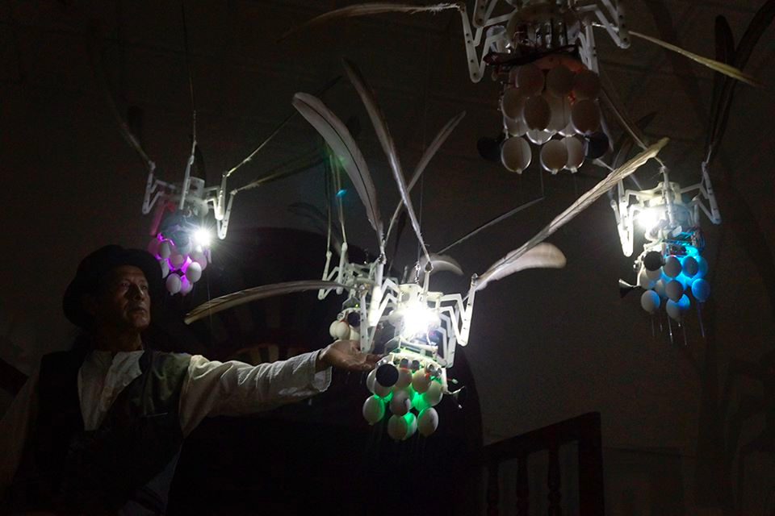
Amaru Cholango, Cochasquí, 2014. Cybernetic installation, variable dimensions. Casa de la Cultura de Quito –Ecuador.

Slide 10


Slide 11
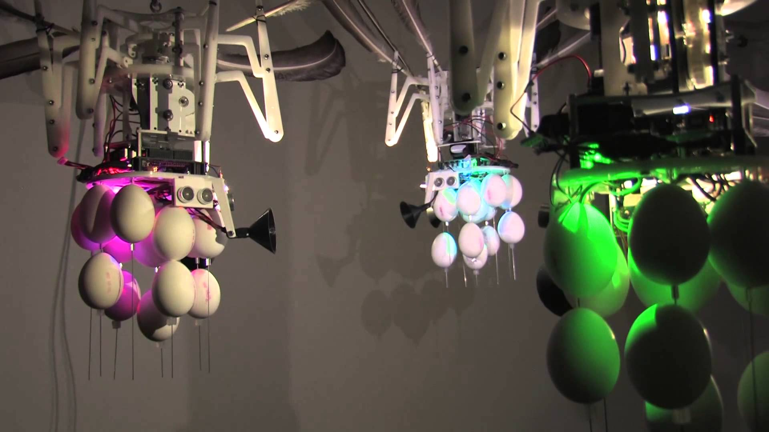
Amaru Cholango, Cochasquí, 2014. Cybernetic installation, variable dimensions. Casa de la Cultura de Quito –Ecuador.

