Slide 1
Code-Switching:
Queering Media Art Histories
RE:TRACE – 7th International Conference for
Histories of Media Art, Science and Technology
Richard Rinehart
Samek Art Museum
Bucknell University
r.rinehart@bucknell.edu
@rick_rinehart

Slide 2
“Queer utopian practice is about ‘doing’ and ‘building’ in response to the status of nothingness assigned to us by the heteronormative world.”
José Estaban Muñoz

Slide 3
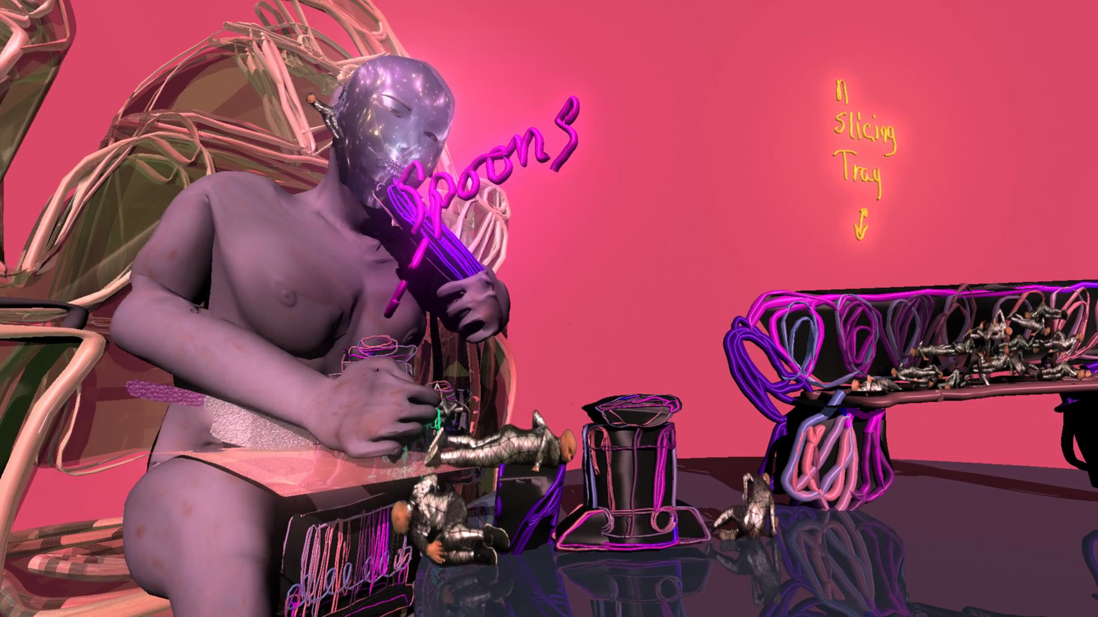
Jacolby Satterwhite, Reifying Desire 5

Slide 4
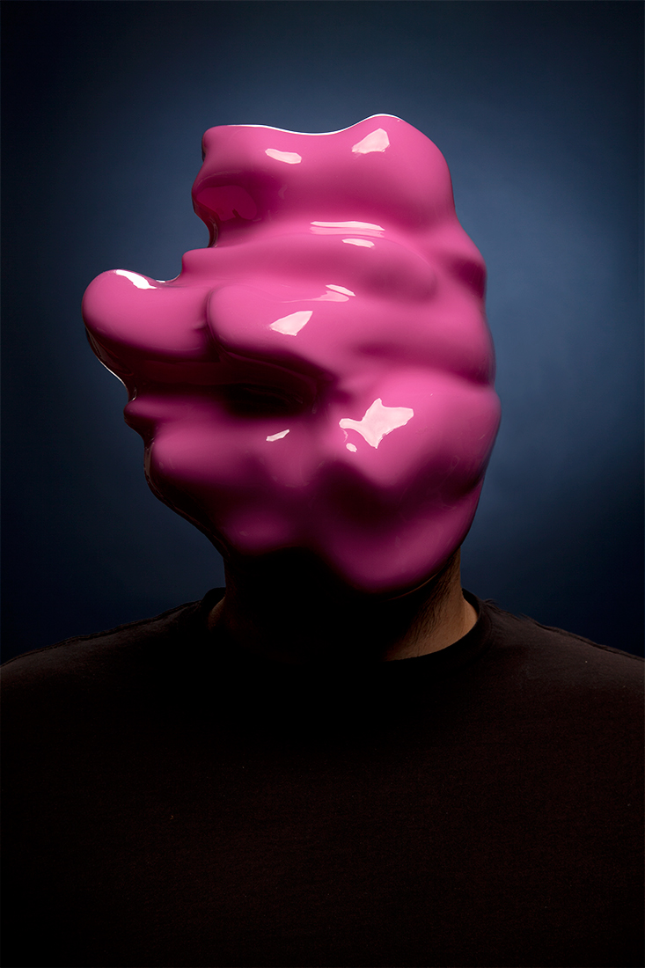
Zach Blas, Fag Face Mask

Slide 5
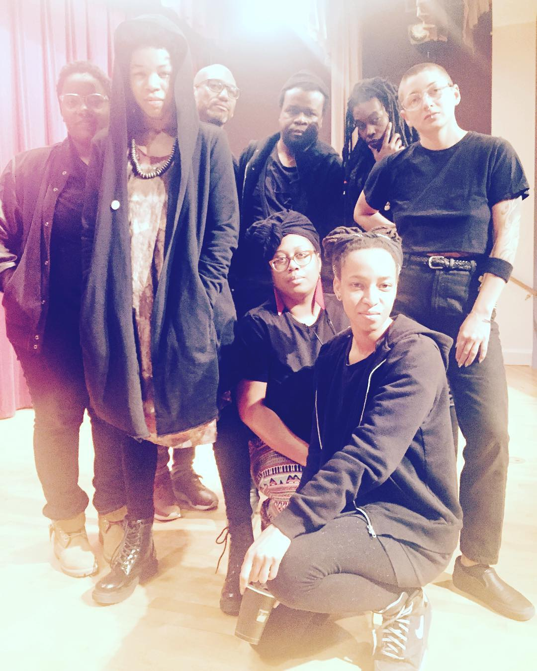
Metropolarity

Slide 6
Marcia Simon Weisman Residence, Circa 1962, Hans Hofmann painting on far wall

Slide 7
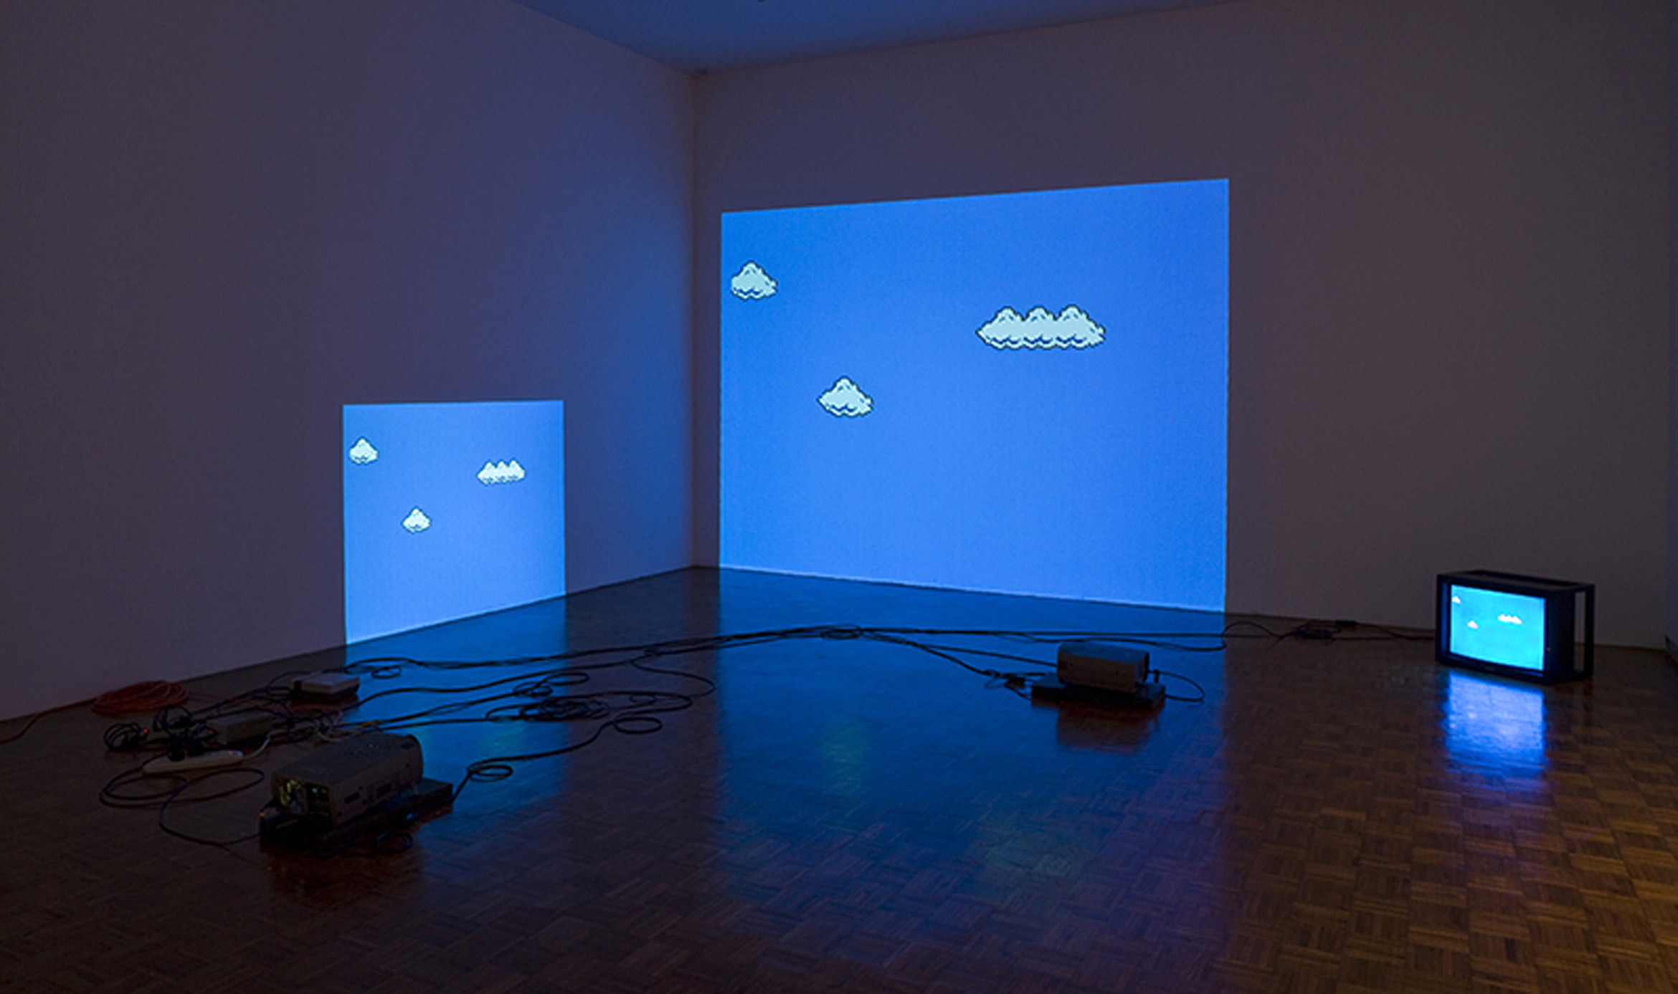
Cory Arcangel, Super Mario Clouds

Slide 8


Alice Weidel, top; Milo Yiannopolous, bottom

Slide 9
Often we can glimpse the worlds proposed and promised by queerness in the realm of the aesthetic. The aesthetic, especially the queer aesthetic, frequently contains blueprints and schemata of a forward-dawning futurity.
José Estaban Muñoz

Slide 10
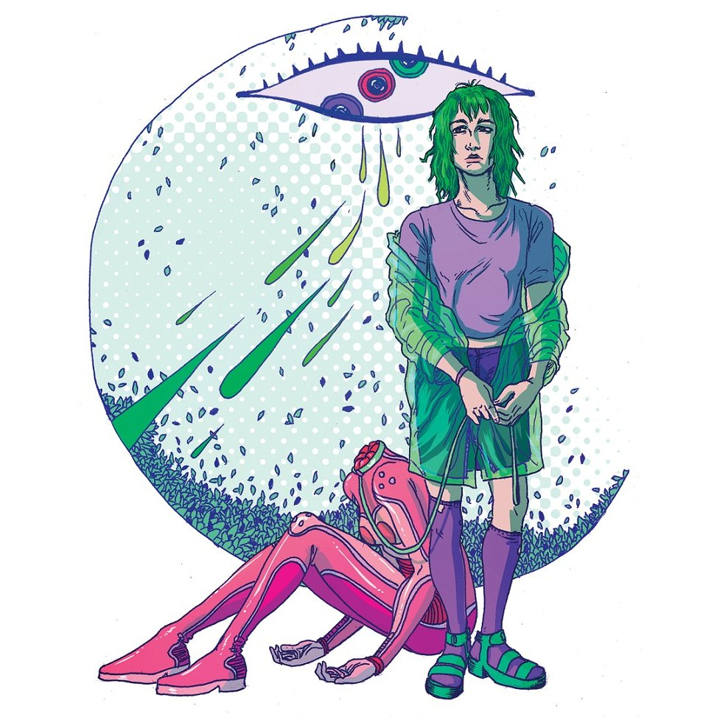
Porpentine Charity Heartscape, Neotenomie, & Sloan; Psycho Nymph Exile

Slide 11
Thank You
RE:TRACE – 7th International Conference for
Histories of Media Art, Science and Technology
Richard Rinehart
Samek Art Museum
Bucknell University
r.rinehart@bucknell.edu
@rick_rinehart

