Slide 1
Gaming Formalism and the Aesthetics of Empathy
Grant Bollmer
Assistant Professor of Media Studies, North Carolina State University
Honorary Associate, University of Sydney
@grantbollmer

Slide 7
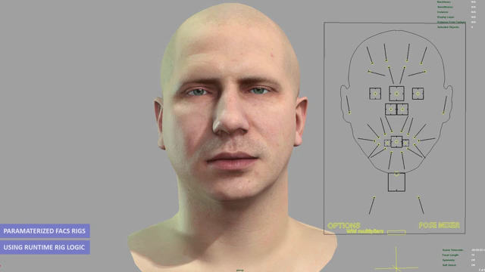

Slide 8
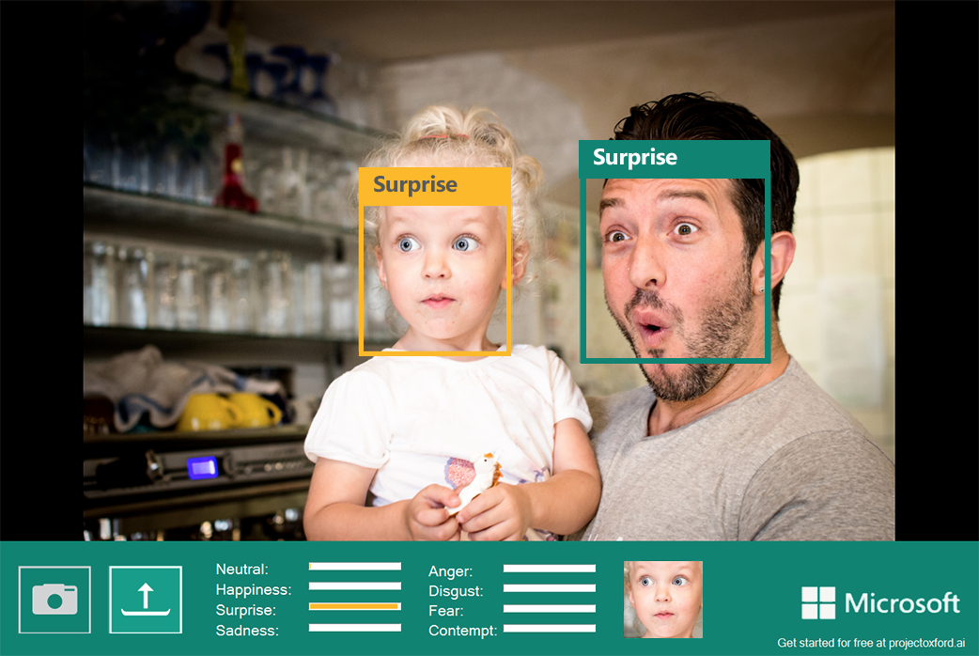

Slide 13
When I see a gesture, there exists within me a tendency to experience in myself the affect that naturally arises from that gesture. And when there is no obstacle, the tendency is realized. Then the idea of the affect in the other’s gesture, or the thinking of the affect into the gesture, has then become the experience of the affect, has become fellow-feeling [Mitfühlen] or sympathy.

Slide 14
In the perception and comprehension of certain sensory objects, namely, those that we afterward represent as the body of another individual (or generally as the sensory appearance of such), is immediately grasped by us. This applies particularly to the perception and comprehension of occurrences or changes in this sensory appearance, which we name, for example, friendliness or sadness. This grasp happens immediately and simultaneously with the perception, and that does not mean that we see it or apprehend it by means of the senses. We cannot do that, since anger, friendliness, or sadness cannot be perceived through the senses. We can only experience this kind of thing in ourselves.

Slide 17
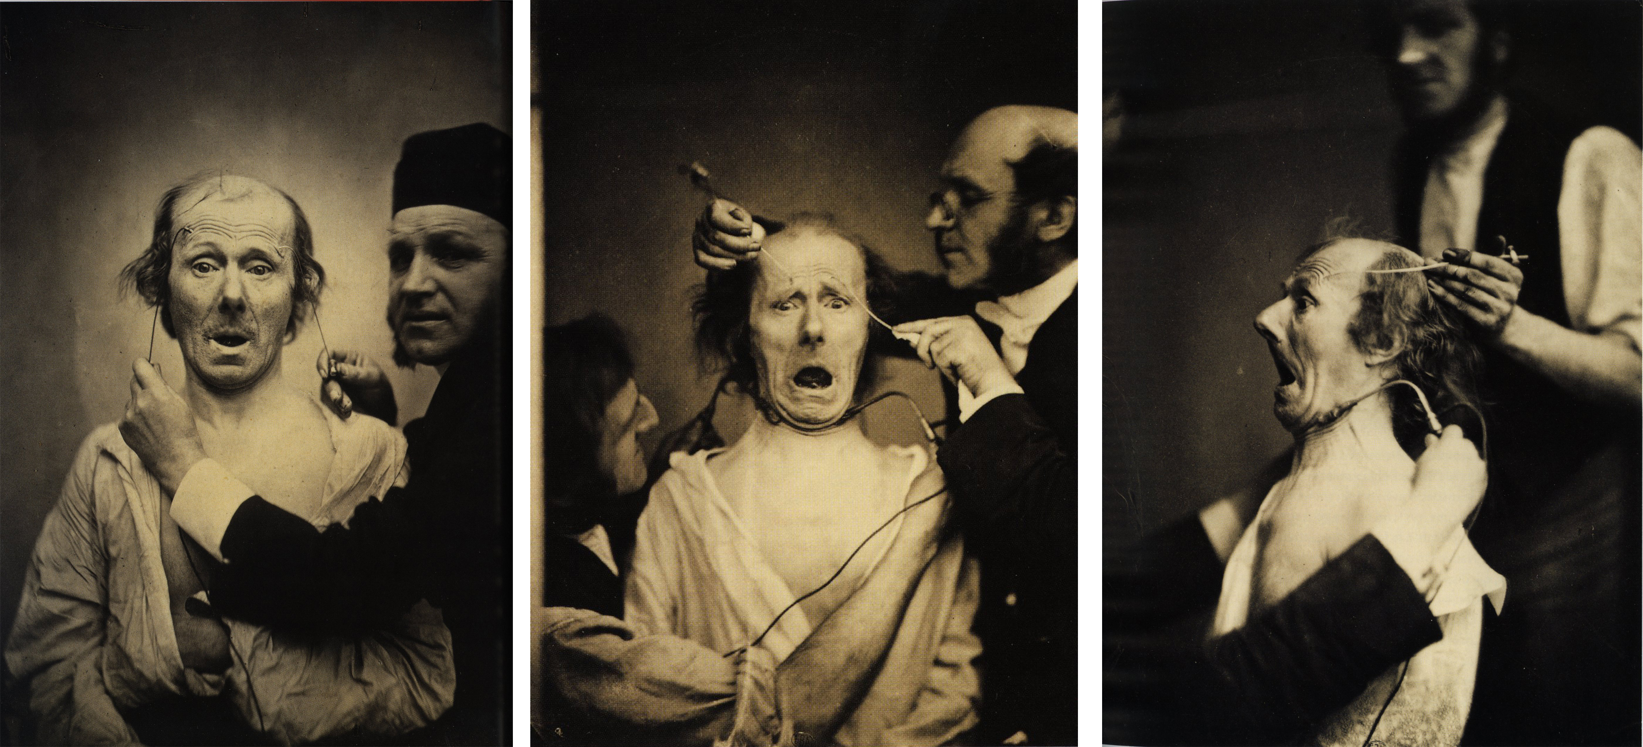

Slide 18
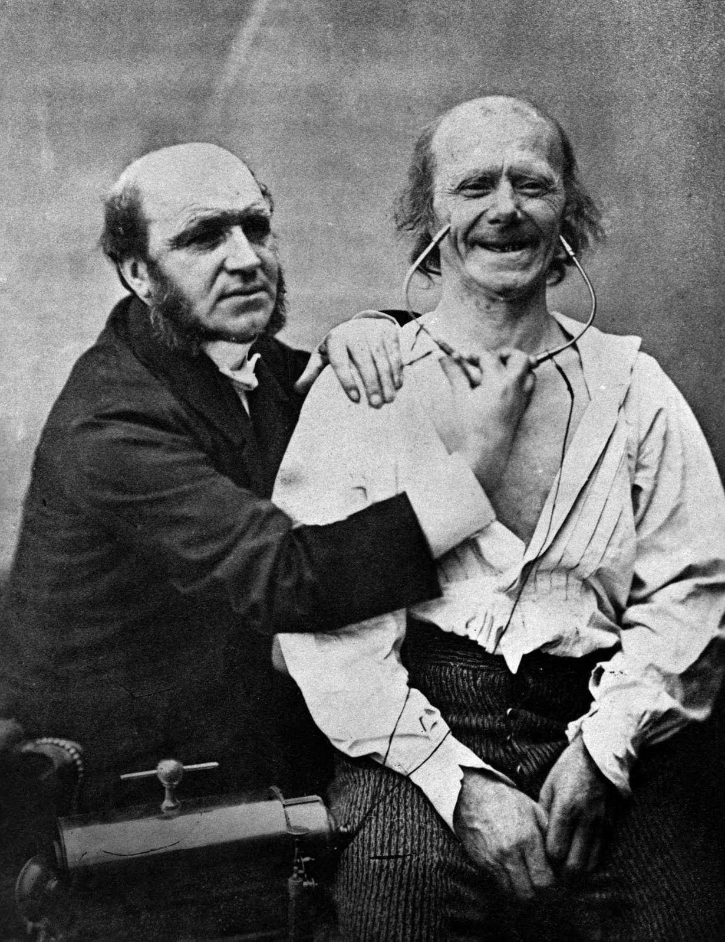

Slide 19
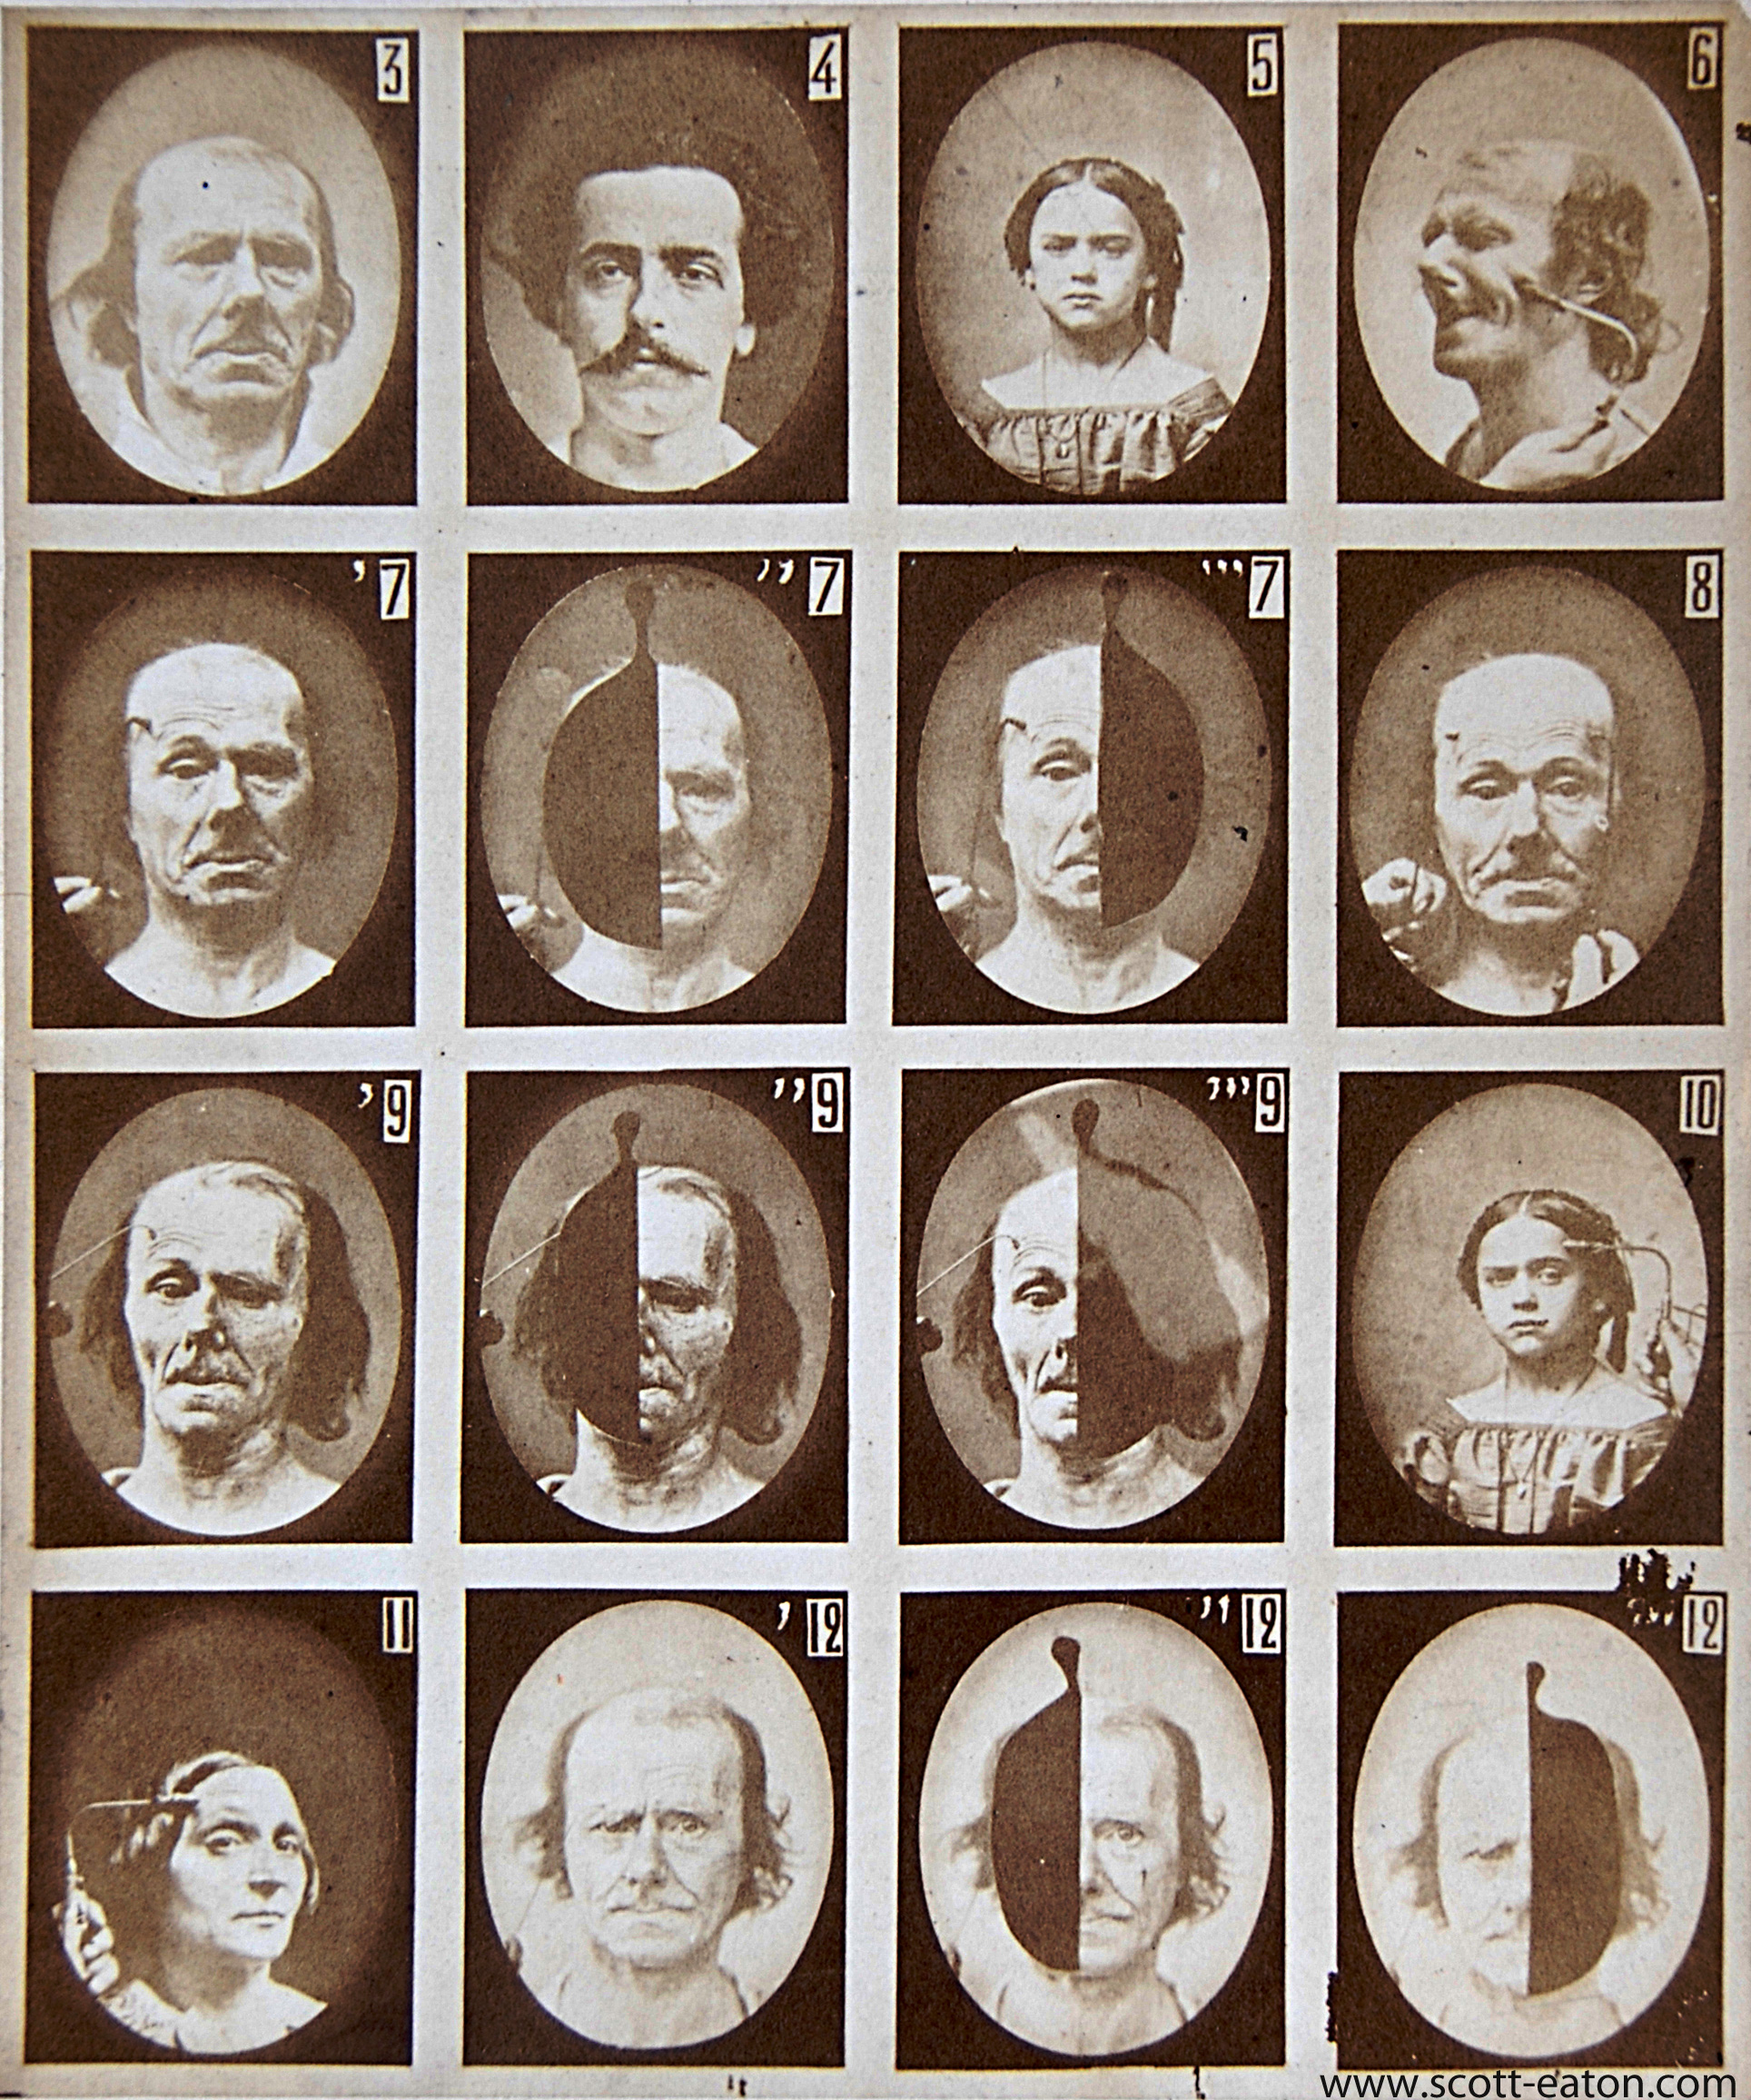

Slide 23
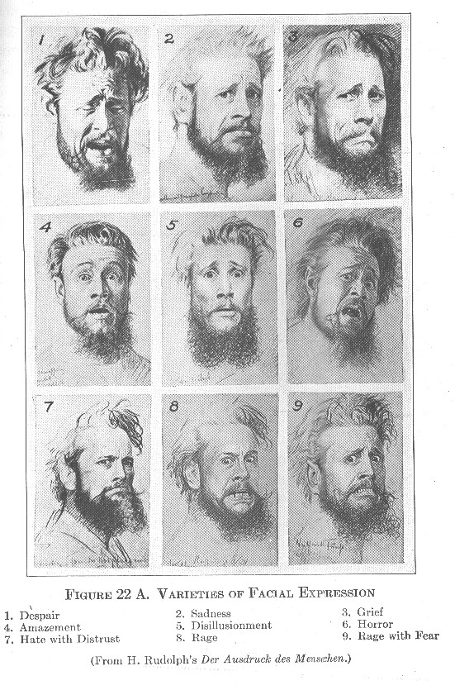

Slide 25


