Slide 1


From Soft Sculpture to Soft Robotics: Retracing a Physical Aesthetics of Softness and the “Life-like”
Jonas Jørgensen
PhD fellow
IT University of Copenhagen
Notes:
Jonas Jørgensen. PhD fellow at the IT Univ. of Copenhagen
Today I will be presenting my paper “Prolegomena for a Transdisciplinary Investigation into the Materialities of Soft Systems”.
Would like to point out, that the thinking and practice presented here is still very much a work in progress, so I will appreciate any comments you might have on the work.
My paper deals with ”soft robots” and materiality.
Will start by introducing the research field of soft robotics
Move to three examples of soft robots in contemporary media art
I will then interrogate different notions of materiality within technical research on soft robots
Finally I will present some of my own practical work involving soft robots
Coming from a background in physics and art history writing this paper has been a means for me to think about how to approach soft robots in a way that leaves room for both natural science and aesthetics.
But also about how to create a productive interplay between these two different approaches to matter.
Overall the paper argues that:
- Soft robotics as a phenomenon and a set of practices should be seen as giving prominence to materiality and the enactive and processual potential of soft matter.

Slide 2
I. INTRODUCTION

Slide 3
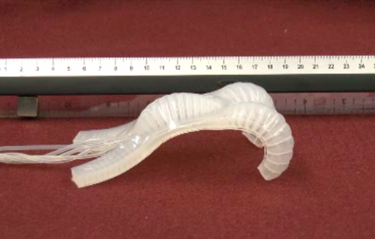
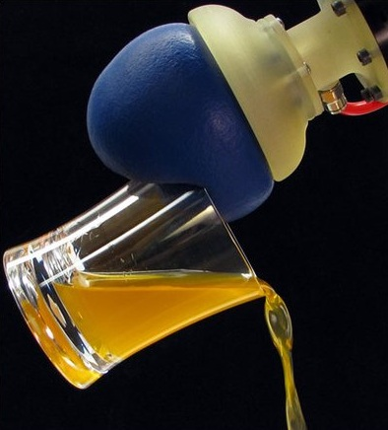
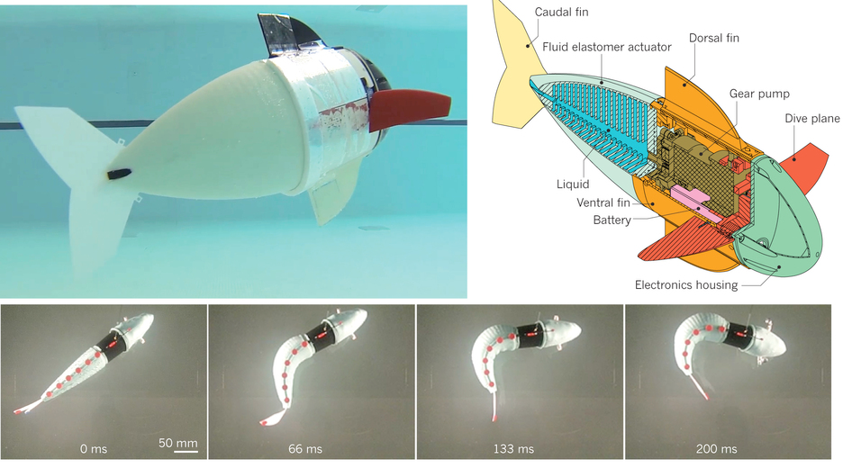
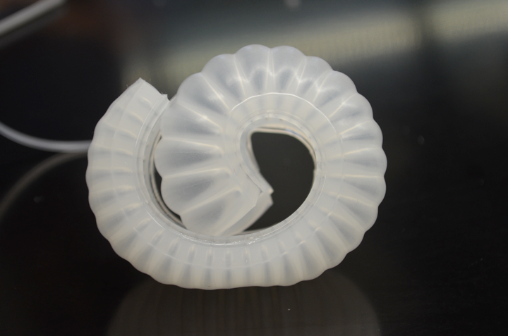
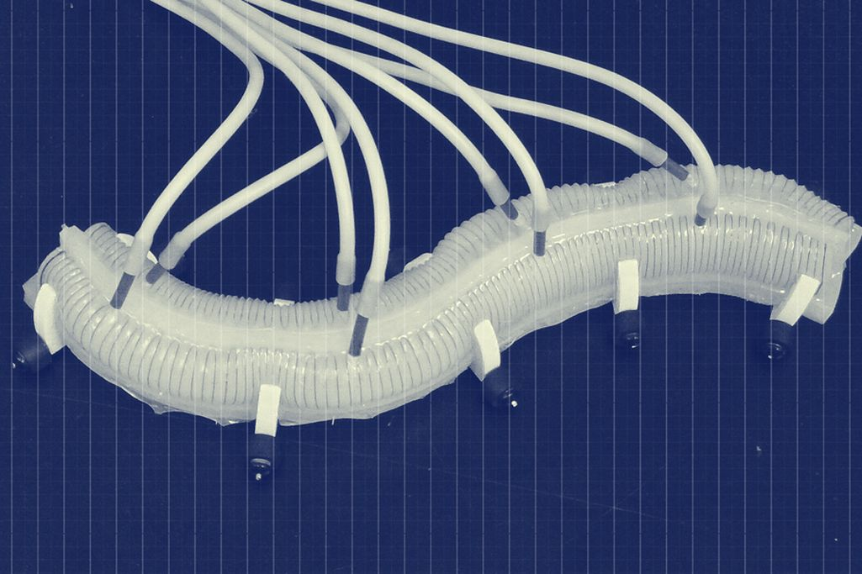
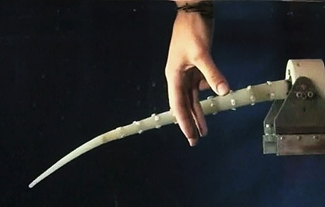
Soft robotics
(technical research)
“systems that are capable of autonomous behaviour, and that are primarily composed of materials with [elastic] moduli in the range of that of soft biological materials” (Rus & Tolley, 2015)
Notes:
Soft robotics has in the past five to ten years become established as an emerging sub field within technical robotics research.
Soft robots: Fully or partially soft morphologies, designed to exploit the benefits of this feature.

Slide 4
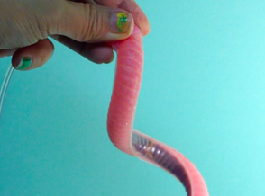
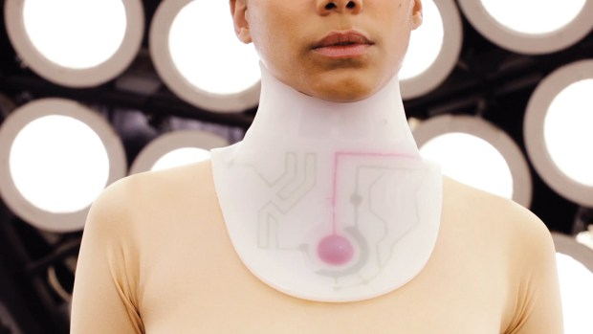
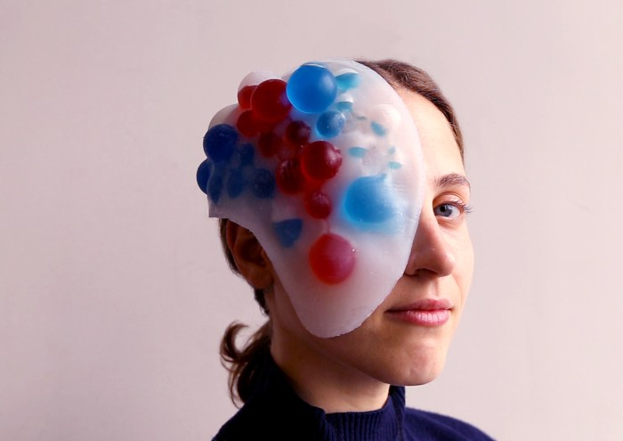
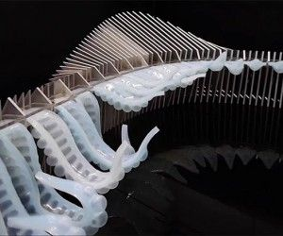
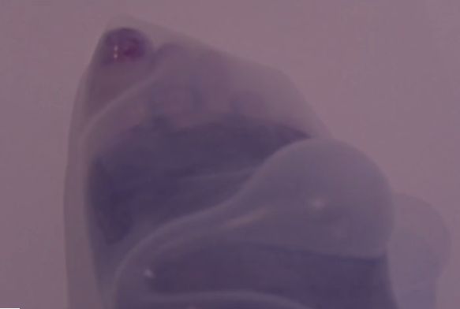
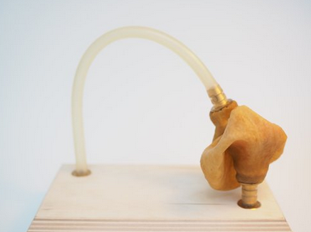
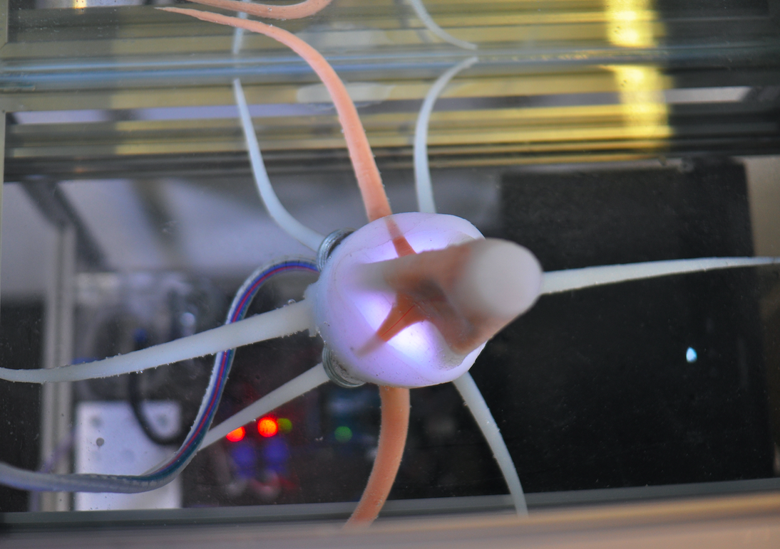
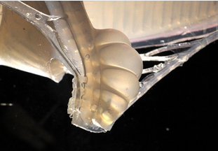
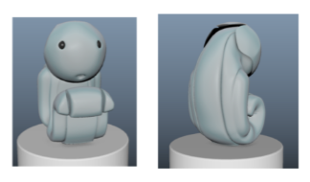
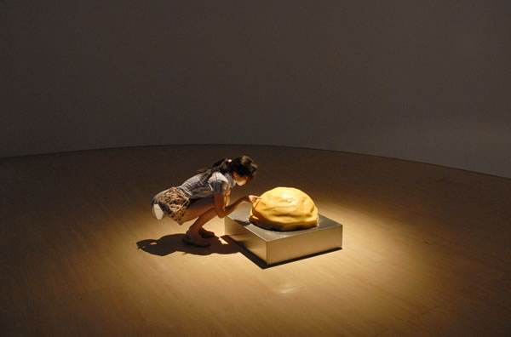
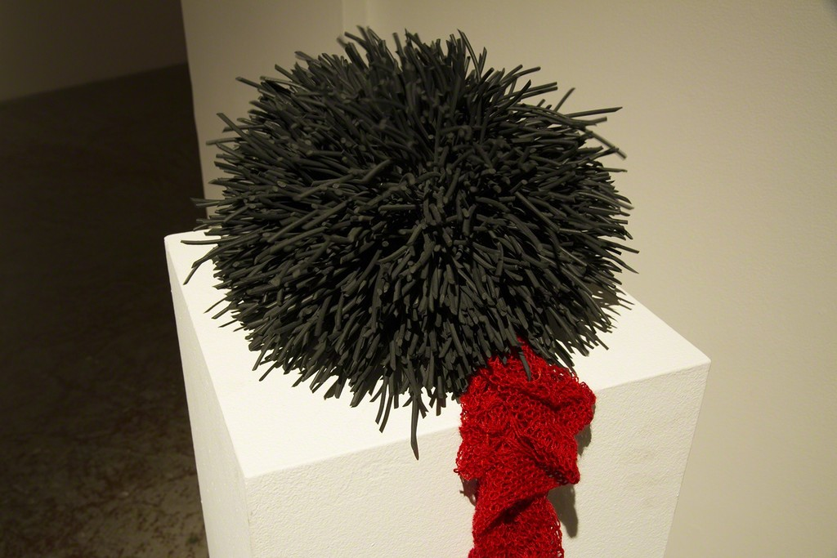
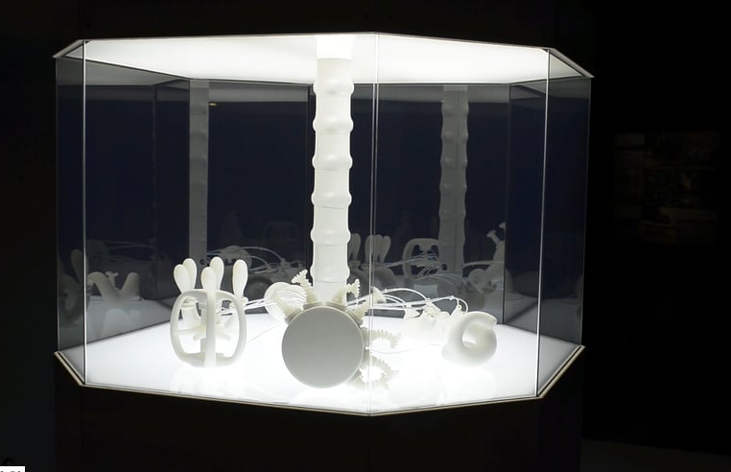
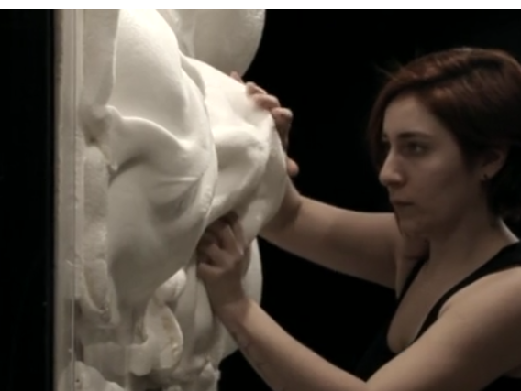
Soft robotics in art, design, and architecture
Sarotis project
Caroline Yan Zheng
Aposema mask
Bijing Zhang & Francois Mangion
Michael Wihart
Mia Hultgren
Jonas Jørgensen
Harvey Bewley
Avner Peled
Ingrid Bachmann
Paula Gaetano Adi
Jonathan Pêpe
Ece Polen Budak and Ozge Akbulut
Notes:
robots built from elastic materials

Slide 5
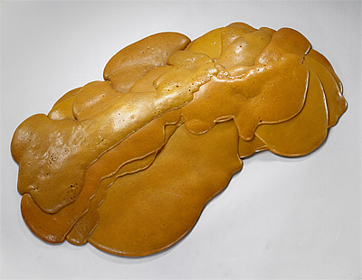
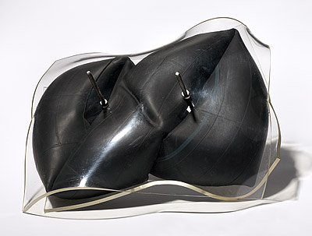
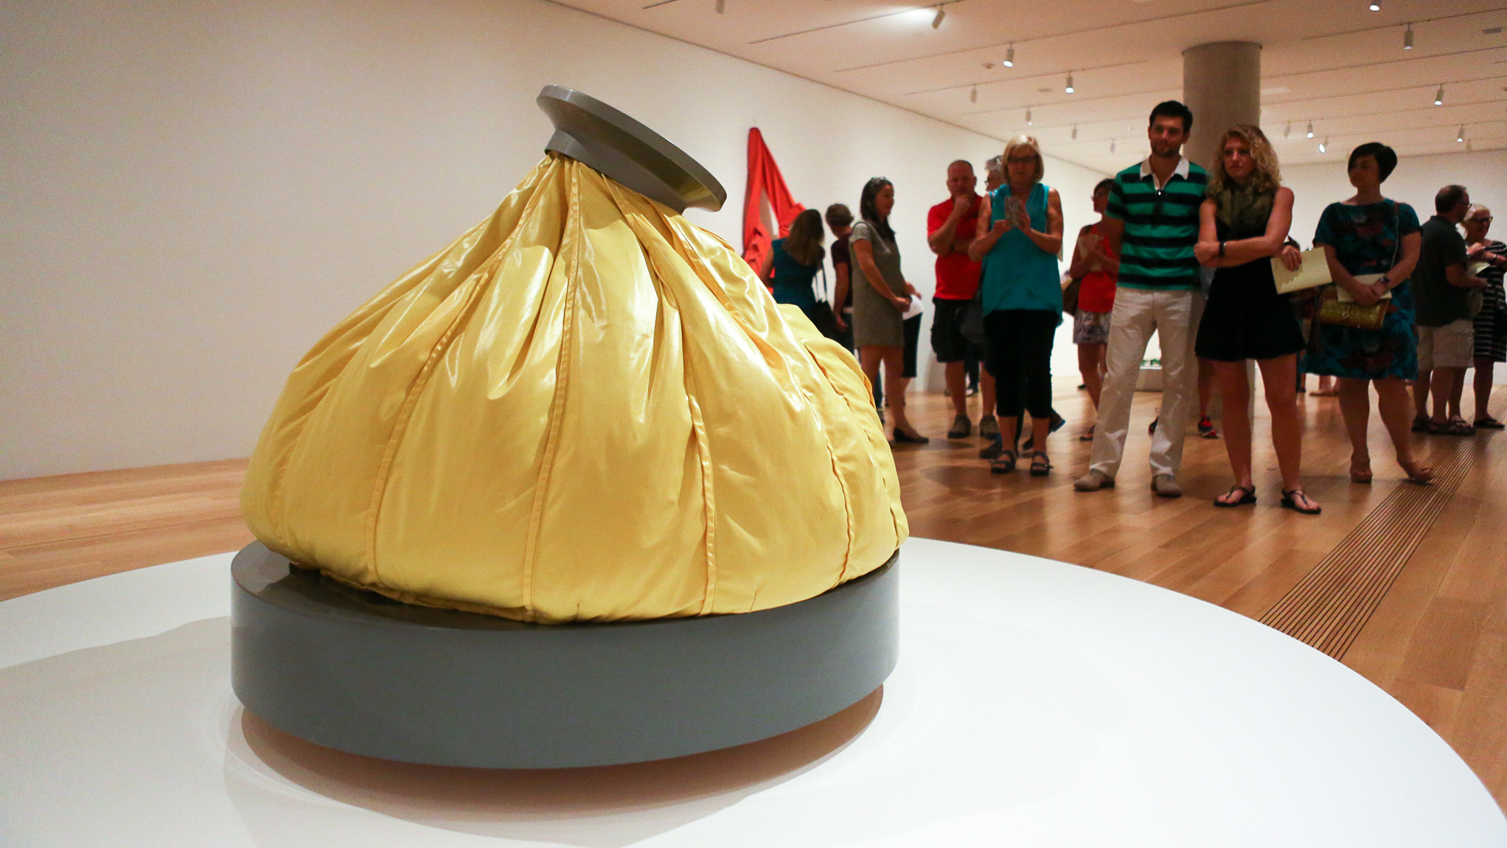
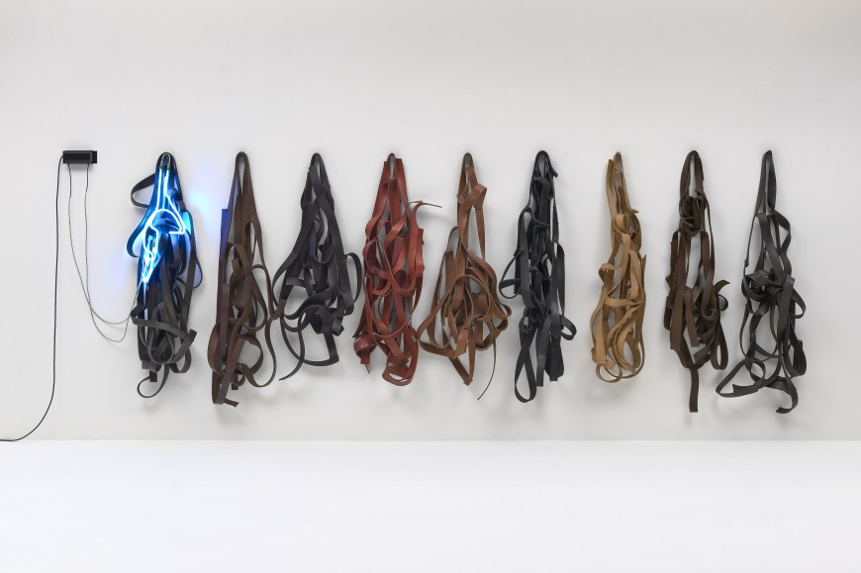
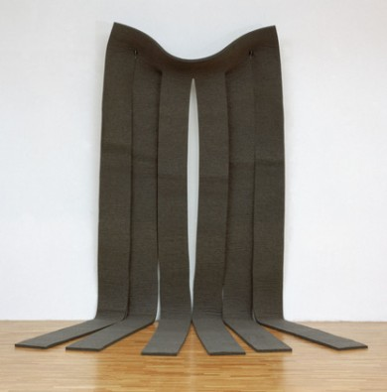
soft sculpture as a prehension of a contiguity that exists between softness and “the life-life”

Slide 6
II. SOFT ROBOTS

Slide 7
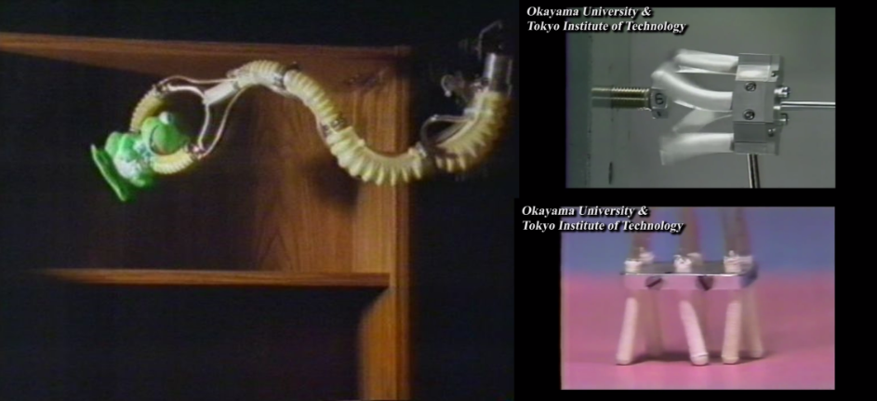
A (too?) short history of soft robotics

Slide 8

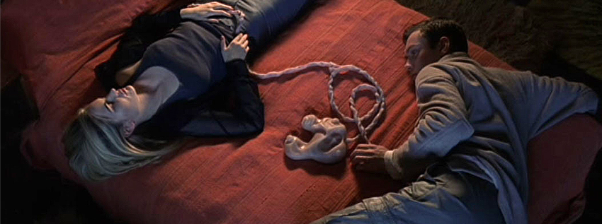
An extended history of soft automata
Karel Čapek, R.U.R. (1920)
eXistenZ (1999, dir. David Cronenberg)

Slide 9
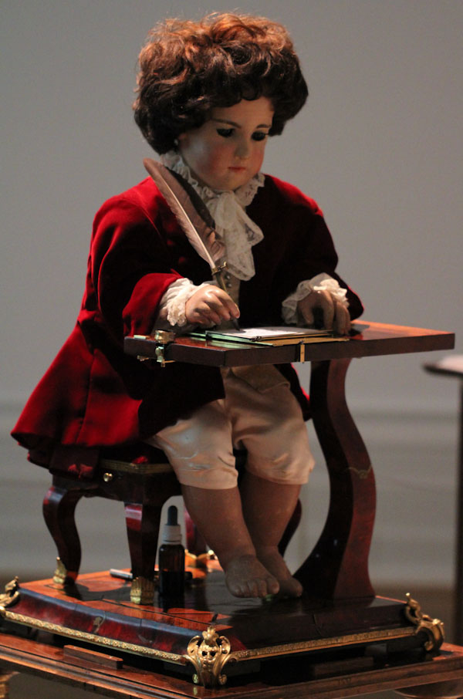
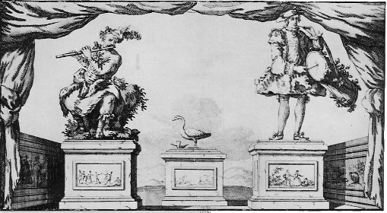
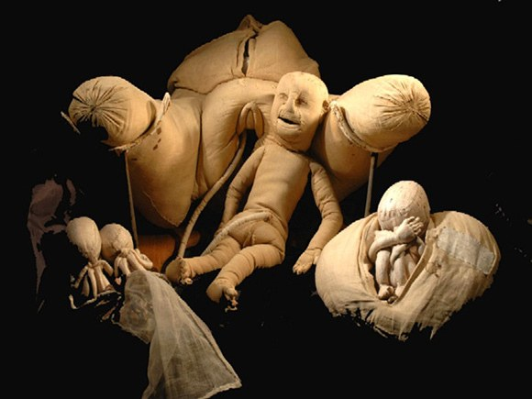
An extended history of soft automata
The Jaquet-Droz family’s writer, 1774.
Etching showing Jacques de Vaucanson’s three famous automata: flute player (left) (1738), digesting duck (center) (1738), and tambourine player (right).
Madame Du Coudray’s “birthing machine”, 1750s

Slide 10
An extended history of soft automata
“an artificial model of a living creature should be soft, flexible, sometimes also wet and messy, and in these ways should resemble its organic subject.”(Riskin, 2003: 112)

Slide 11
III. SOFT (LIFE-LIKE) SCULPTURE

Slide 12
Oldenburg’s soft sculptures―mechanised or not―never simply ‘sit on their arses’. … the works take on their own life and exist in a constant state of flux. (Lucina Ward)
Claes Oldenburg, Ice Bag -- Scale B, Yellow, 1971

Slide 13
Morris’s scattered felt strips obliquely allude to the human body through their response to gravity and epidermal quality. (the Guggenheim Museum)
The order and symmetry of the cut cloth is contradicted by the graceful sag at the top, which gives it some human qualities. (MOMA)
Robert Morris, Untitled, 1969. Felt, 15' 3/4" x 6' 1/2" x 1" (459.2 x 184.1 x 2.5 cm)

Slide 14
The piece’s anthropomorphic quality—the belts suggest limp figures or twisted harnesses … (the Guggenheim Museum)
Richard Serra, Belts, 1966–67, Vulcanized rubber and neon, 182.9 x 762 x 50.8 cm.

Slide 15
‘Dionysian’, ‘erotics of Anti-Form’ (Robert G Edelman)
The artist is not coy about bodily associations―going so far as to liken the ‘flow’ of another early polyurethane work to an orgasm (Lucina Ward)
Lynda Benglis, Untitled (Polly's pie II) 1968, pigmented polyurethane foam. 15.2 x 139.7 x 83.8 cm

Slide 16
Despite the fact that all the elements of Tubeseed (A) are manufactured, there is a curious sense of the organic, of a growing entity which seems to push out of its ‘shell’. (Lucina Ward)
Hilary ARCHER, Tubeseed (A) 1972

Slide 17
soft sculpture as a prehension of a contiguity that exists between softness and “the life-life”

Slide 18
IV. PROCESS/FORCES

Slide 19
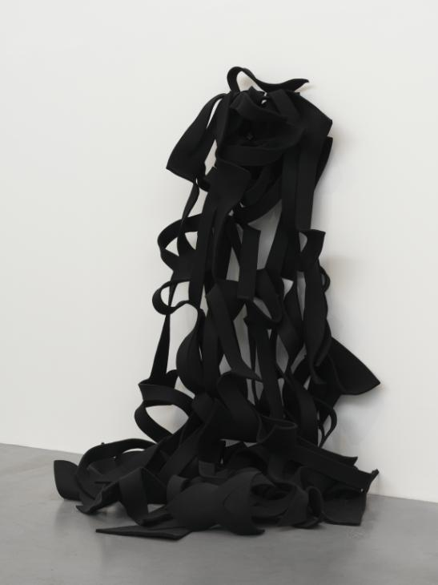
Robert Morris, Untitled, 1967–8, remade 2008, felt.

Slide 20
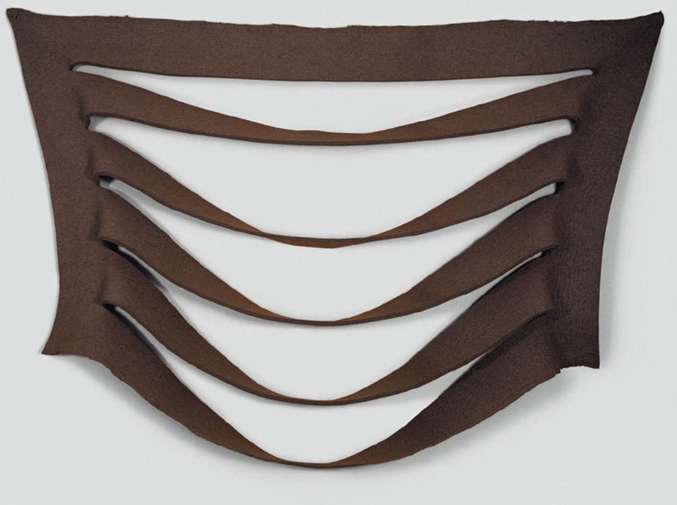
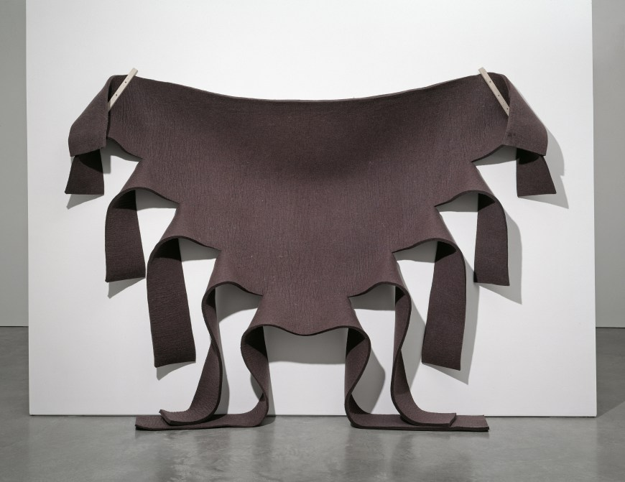
Robert Morris, Untitled (Brown Felt), 1973
Robert Morris, Untitled, 1967 Grey felt and metal mounting plates 198.1 x 348 x 43.2 cm

Slide 21
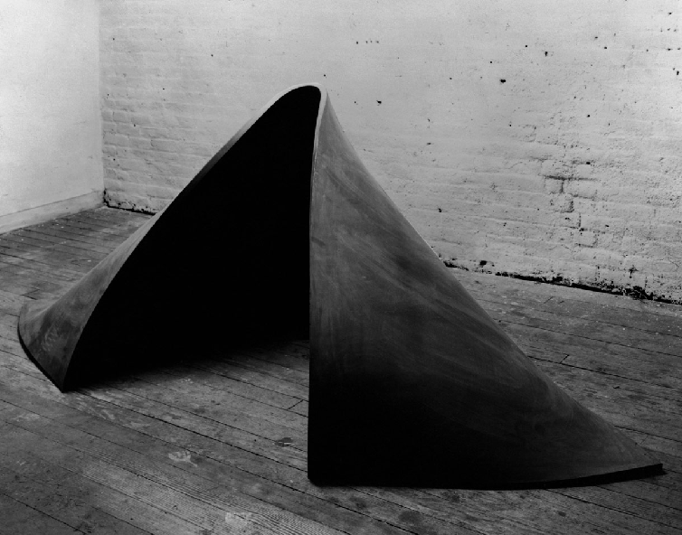
Richard Serra, To Lift, 1967. Vulcanized rubber, 36" x 6' 8" x 60" (91.4 x 200 x 152.4 cm)

Slide 22
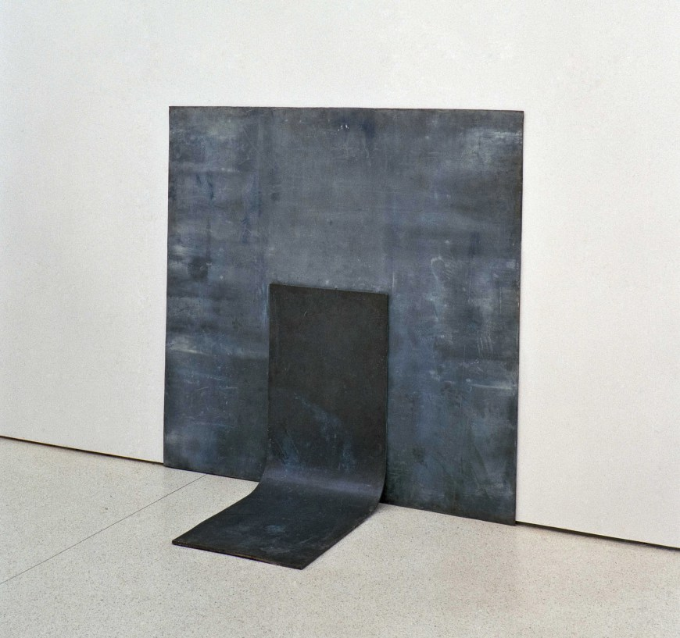
mechanical properties of the materials contribute to an end, that would not be attainable were the properties slightly different
Richard Serra, Right Angle Prop, 1969, lead antimony, 182.9 x 182.9 x 86.4 cm.

Slide 23
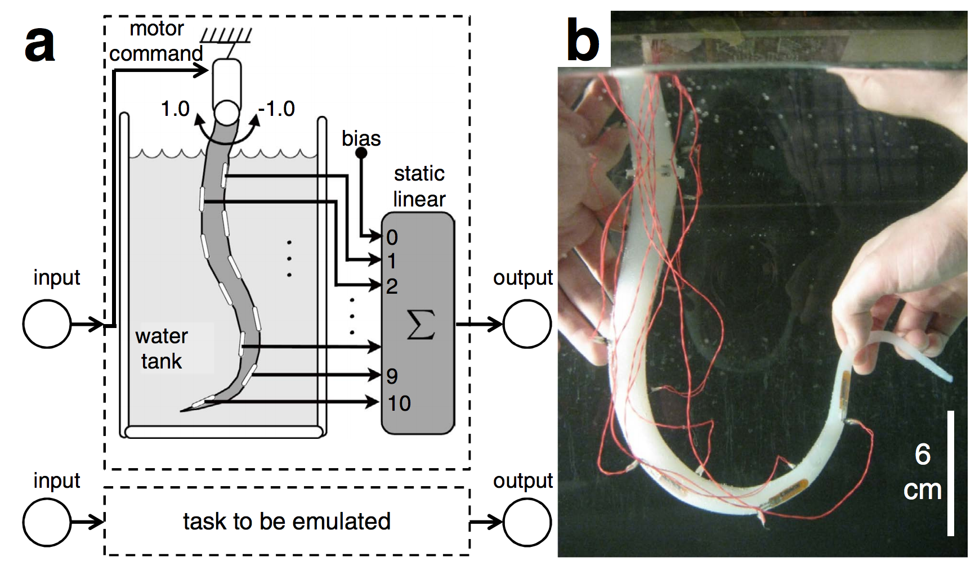
Morphological computation
“[T]he tasks that in the classical approach are performed by the control system can be made partially redundant by the mechanical properties of the physical body itself … the complex, precise control architecture can be simplified using highly compliant materials with variable stiffness, where the control is in part embedded in the morphology of the body ...” (Laschi and Cianchetti, 2014:2)
Notes:
The calculations done by complex filters can be achieved in physical mass-spring systems that stand in for the robot body.
The morphology provides the computational processes
“compliant, complex physical bodies can be ef- fectively employed as computational resources“
“real physical bodies are employed as computational resources ”
EcoFlex: tires – computation changes, it evolves, decays. Errros produced -> liveness?

Slide 24
V. ENTROPY

Slide 25
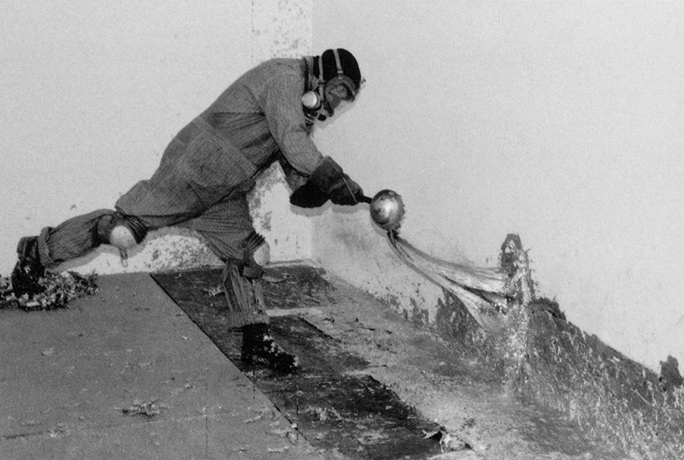
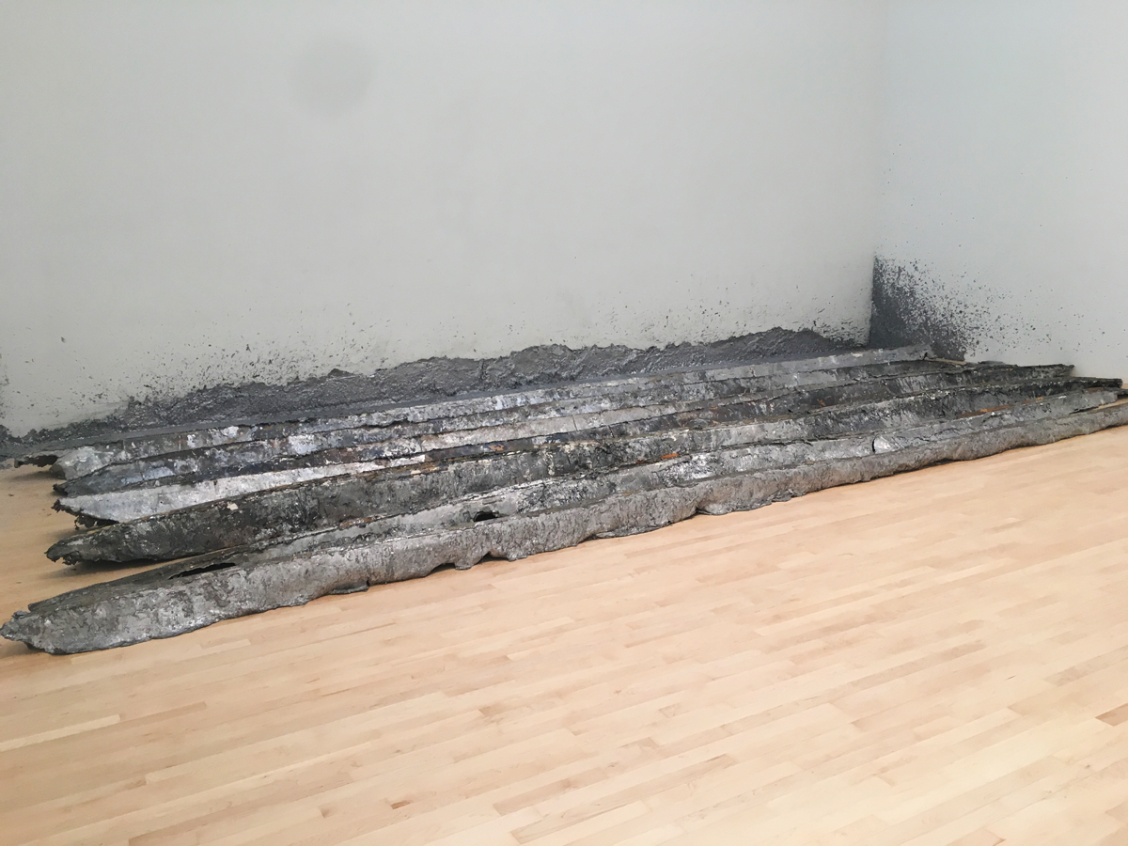
Entropy
related to the number of microstates of a given system,
an expression of its number of degrees of freedom
a measure of disorder
Life
seems to evade the second law of thermodynamics - all physical processes yield a net increase in entropy.
organisms evade the decay to thermodynamical equilibrium by continually exporting entropy to their surroundings.
not located within a living organism
inherent in the relation an organism sustains with its environment.
Richard Serra, Casting, 1969.
Richard Serra, Gutter Corner Splash: Night Shift, 1969/1995

Slide 26
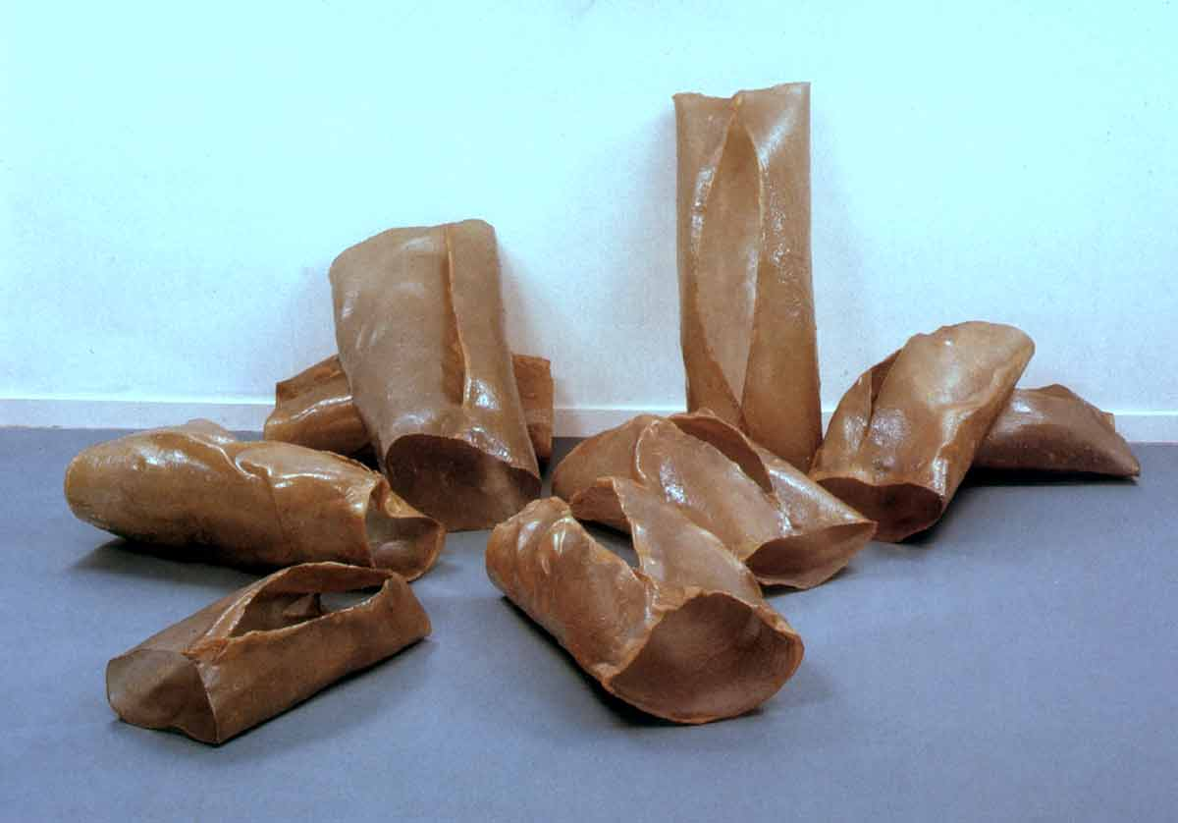
From Philadelphia Museum’s description of the work:
“The nine forms that make up this work are organic and rigid, fleshy and repellent, corporeal and otherworldly.”
“..its apparently casual arrangement looking more like something discovered by chance than deliberately set in place. “
Eva Hesse, Tori (1969),

Slide 27
“When we look at Hesse’s three-dimensional work, we are looking at ourselves … Hesse shows us that the body itself is a tension between imposed, regulating structures and a substance that is never entirely subsumed by them” (Darian Leader, 2002)

Slide 28
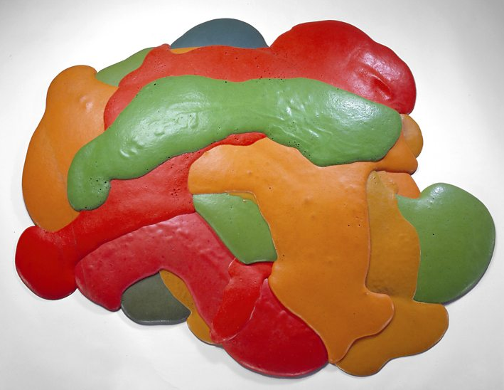
Lynda Benglis, Night Sherbert A, 1968, Dayglo pigment, phosphorescence and poured polyurethane foam.

Slide 29
VI. CONCLUSION

Slide 30
Biodegradable soft robots
Rossiter, J. et al “Here today, gone tomorrow: biodegradable soft robots” (2016).
Notes:
At Bristol Robotics Laboratory the transformational properties of matter are also leveraged.
This occurs not just in the fabrication process but for the actual functioning of their soft robots.
The researchers here are experimenting with using biodegradable materials such as latex rubber and gelatine instead of silicone.
This is done to yield autonomous soft robots that may assimilate to and eventually perish in natural environments without causing damage to them.
To summarize:
Within technical soft robotics research:
The enactment of a processual and dynamic physical and chemico-biological materiality is central to both the design, fabrication, and functioning of state-of-the-art soft robots.
[short pause here]

Slide 31
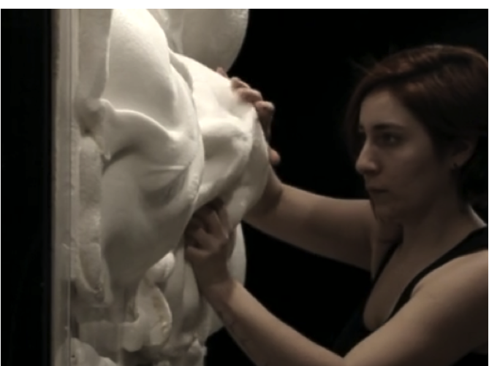
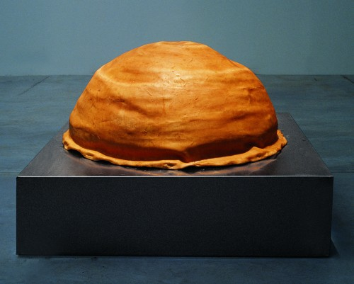
(Soft) Robotic art
”the principle of giving precedence to behaviour over form.” (Kac, 1997: 60)
” a robot is a technological system, which by the integration of sensors and effectors, evidences contingent autonomous behaviour in the physical world.” (Penny, 2013: 149)
Ece Polen Budak and Ozge Akbulut, THE BREATHING WALL (BRALL) (2014-15)
Jonathan Pêpe, Exo-biote, 2015.
Paula Gaetano Adi Alexitimia (2006-2007), Autonomous Robotic Agent, latex, plastic hoses, water pumps, custom electronics.

Slide 32
Questions/comments?
Jonas Jørgensen
jjoe@itu.dk
jonasjoergensen.wordpress.com/

